Slide 1


Resume Analysis System
This presentation showcases the Resume Analysis System, an AI-powered solution designed to automate resume classification, skill extraction, and job matching. It leverages Natural Language Processing techniques and machine learning models to process resumes and assess their fit against job descriptions.
by Shivam Agrawal

Slide 2
The Problem: Time-Consuming and Biased Screening
Manual Screening
The Solution
Recruiters often face the challenge of filtering through hundreds or thousands of resumes, making the process time-consuming and prone to bias.
The Resume Analysis System automates this process by using artificial intelligence to evaluate resumes based on content relevance and alignment with job descriptions.

Slide 3
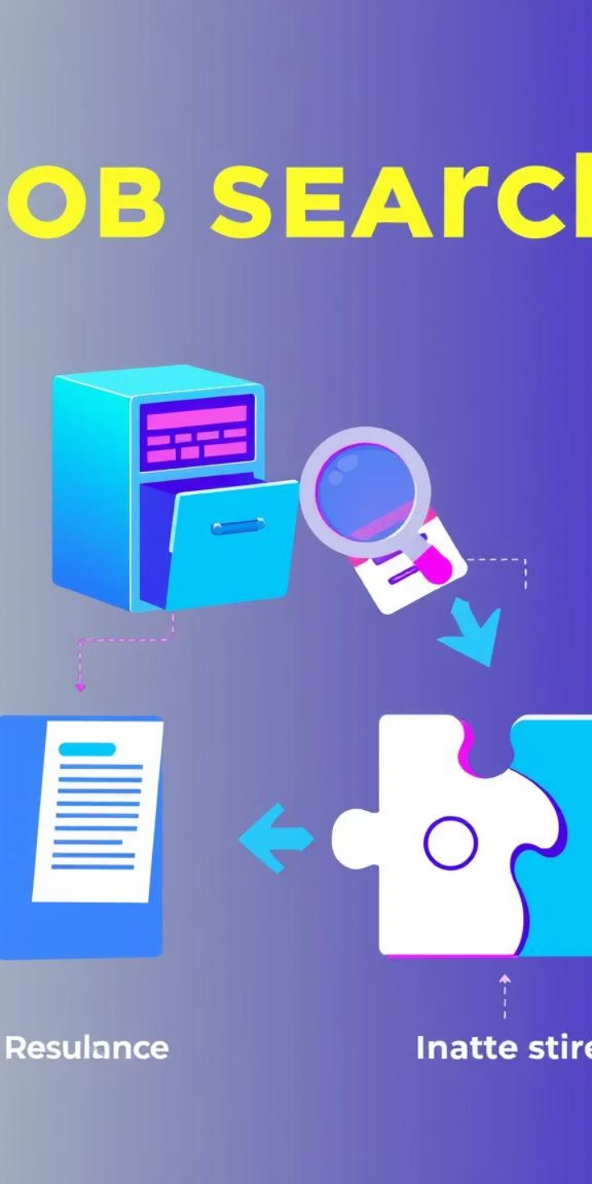
System Architecture: Three Key Components
1
Resume Classification
2
Skill Extraction
Detects key technical and soft skills using pattern matching against a curated keyword database.
Categorizes resumes into roles using Random Forest classifiers trained on TF-IDF vector representations.
3
Job Match Scoring
Computes the match percentage between a resume and provided job descriptions using a weighted scoring system.

Slide 4
Methodology: A Structured Pipeline
Resume Text Extraction
1
Resumes uploaded in PDF format are parsed using PyPDF2. Extracted text is cleaned using regular expressions to remove special characters and standardize formatting.
2
Resume Classification
Text is vectorized using TF-IDF vectorization. Random Forest classifier predicts the most suitable job category. The classifier is trained using the models stored in the models directory.
Skill Extraction
3
A comprehensive dictionary of technical and soft skills is maintained in the application. Pattern matching using regular expressions identifies skills present in the resume. Extracted skills are presented as tags in the user interface.
4
Job Description Matching
The system compares resumes against predefined job descriptions. Match scoring uses a weighted approach: 50% weight for matching skills, 20% weight for education match, and 30% weight for overall text similarity using cosine similarity. Multiple job matches are provided with detailed breakdown of match components.
User Interface
5
A web interface built with Flask and HTML/CSS allows users to upload resumes and view analysis results. Results include categorization, recommended job, contact information, skills, and job matches with scores.

Slide 5
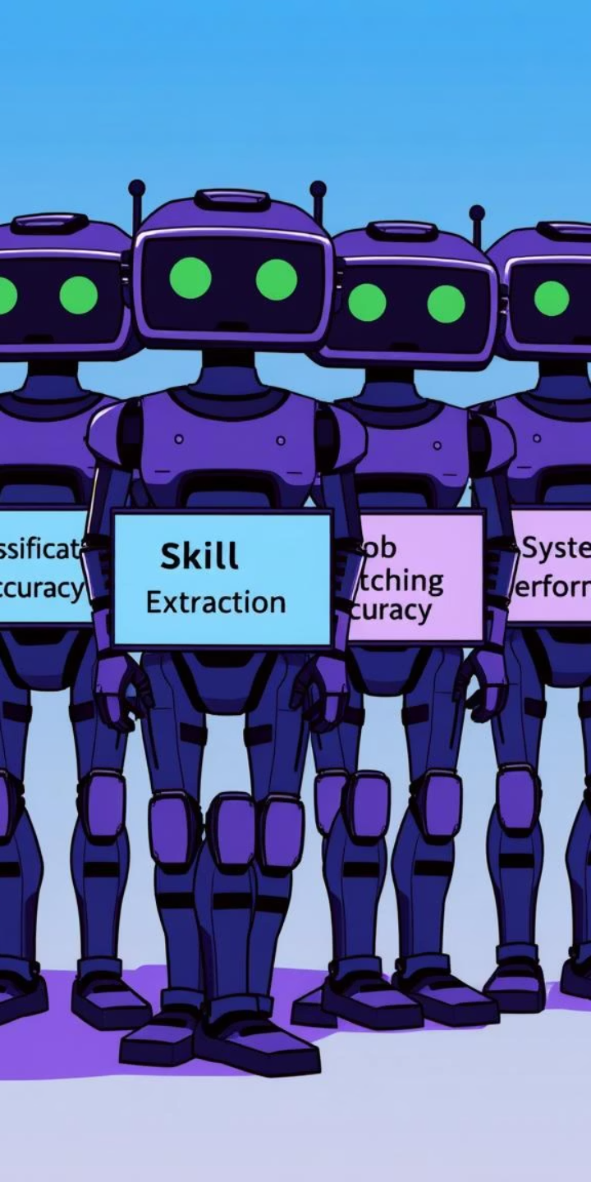
Experimental Results: Performance Evaluation
Classification Performance
Model successfully categorizes resumes into appropriate job roles. Resume categories include: Software Developer, Data Scientist, Manager, etc.
Skill Extraction Efficiency
System effectively identifies over 250+ distinct skills from resumes. Skills are categorized and presented as tags in the UI.
Job Matching Accuracy
Weighted scoring system: 50% skills, 20% education, 30% content similarity. Match scores correlate well with manual review. Top job matches are provided with detailed breakdowns.
System Performance
PDF parsing and analysis completed in under 5 seconds on average. Web interface provides real-time feedback and results.

Slide 6

Conclusions: A Powerful Tool for Recruitment
The Resume Analysis System effectively automates key parts of the recruitment process. It provides accurate job role classification for submitted resumes, extracts relevant skills and education information, calculates comprehensive match scores against job descriptions, and presents results in an intuitive, user-friendly interface.

Slide 7





Future Scope: Expanding Capabilities
Advanced NLP Techniques
Multilingual Support
Interview Question Generation
Implement transformers (e.g., BERT) for better understanding.
Process resumes in multiple languages.
Based on detected gaps or weak areas.
API Integration
Connect with existing HR tools and platforms.

Slide 8

Key Takeaways and Next Steps
The Resume Analysis System is a valuable tool for streamlining the recruitment process, saving time for HR teams and providing objective assessment of resume-job fit. Future development will focus on expanding capabilities through advanced NLP techniques, multilingual support, and integration with existing HR tools and platforms.

